Slide 1


Slide 2

Gym Website System In Asp.nET
Student Name Under Guidance
Rawand Saleem Aljammal Dr. Alaa Abuthawabeh

Slide 3
website aim
Every gym needs a website, however not all websites are created equally. In fact, a gym website is only as good as its ability to help you reach new customers, connect with your existing members, and improve your gym management efforts. Achieving these goals can be made easier with these important gym website features.
We live in a digital society where people are constantly on the move, which means they rely on their mobile devices. No one wants to spend more than a few seconds looking for contact information or an email opt-in feature if they want to quickly sign-up for gym updates.

Slide 4
website aim
Make It Easy For People To Sign-up For Classes. Have you ever visited a gym website that spent a lot of digital real estate talking about their classes? After reading about each class did you discover that you had wasted your time because you had to call to sign-up? The latter scenario is one of the top mistakes that gym owners make when creating their websites. To avoid this mistake you should give site visitors multiple opportunities to sign-up for classes. To do this implement the following strategies:
Current gym member sign-in. The sign-in portal should have a schedule of upcoming classes, as well as the member's previous class history and preferred payment method.
Each class description should have an embedded sign-up form. The form should direct current members to either sign into their profile or use their phone number (or email) to reserve their place in the class. Non-members should be encouraged to create a secure profile or use their phone number (or email) to reserve their spot in the class.

Slide 5
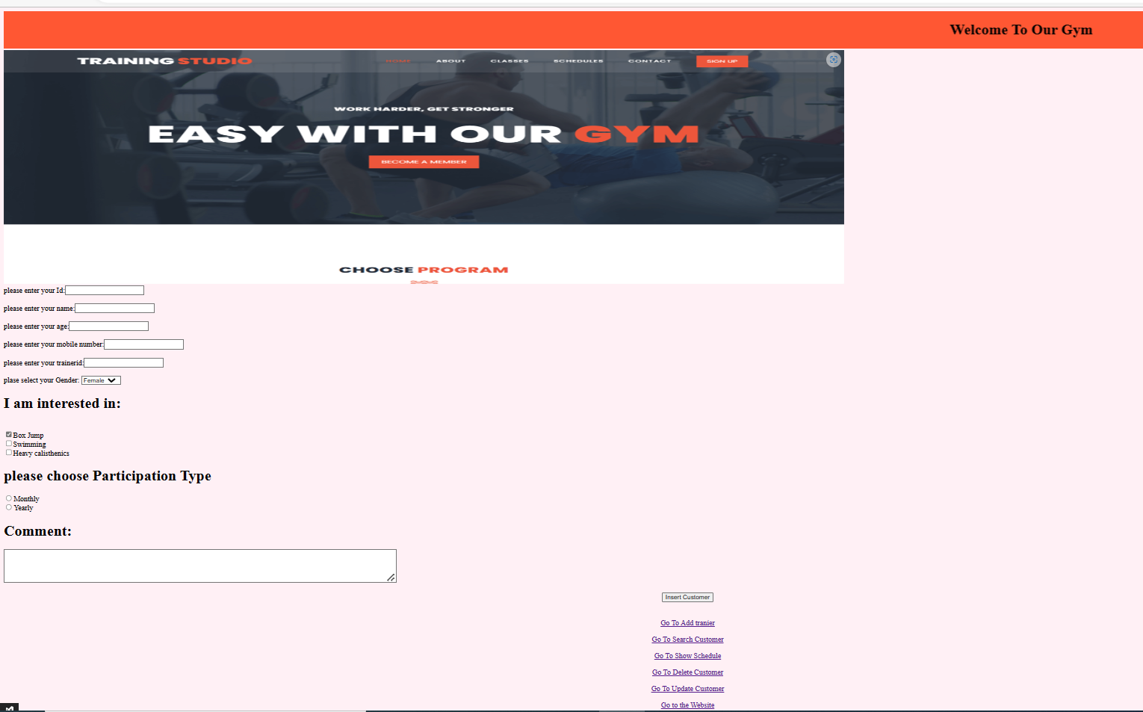

Slide 6
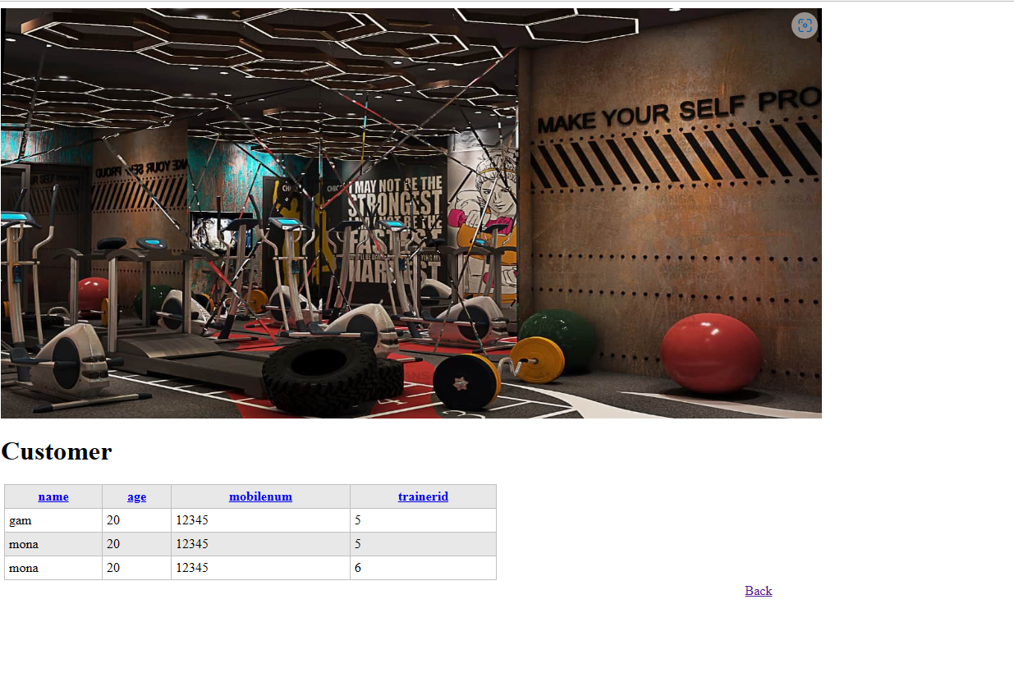
Customer Interface

Slide 7
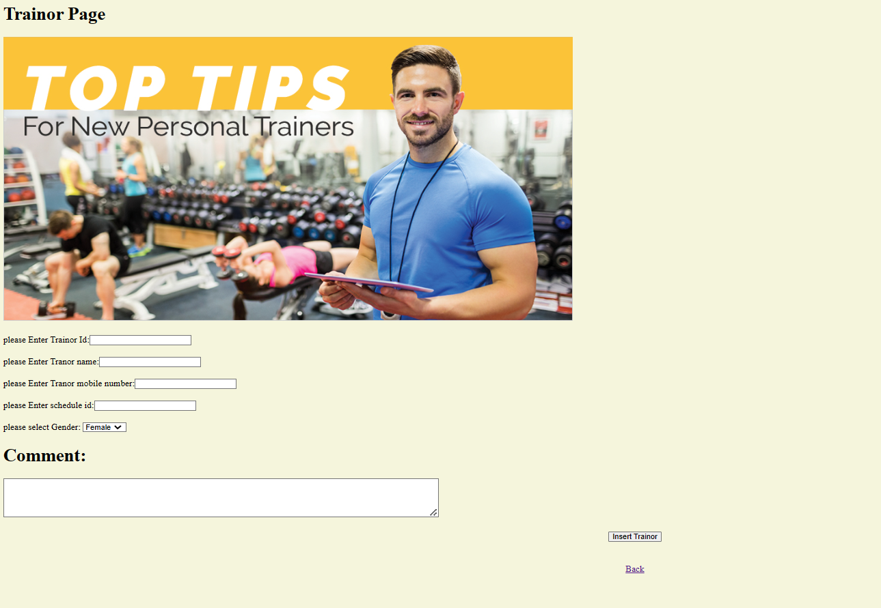
Trainor Interface

Slide 8
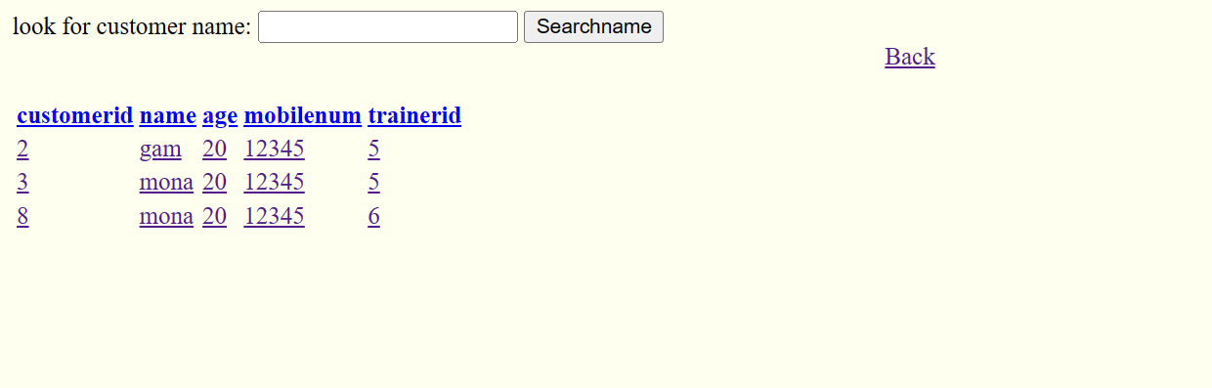
Search Interface

Slide 9
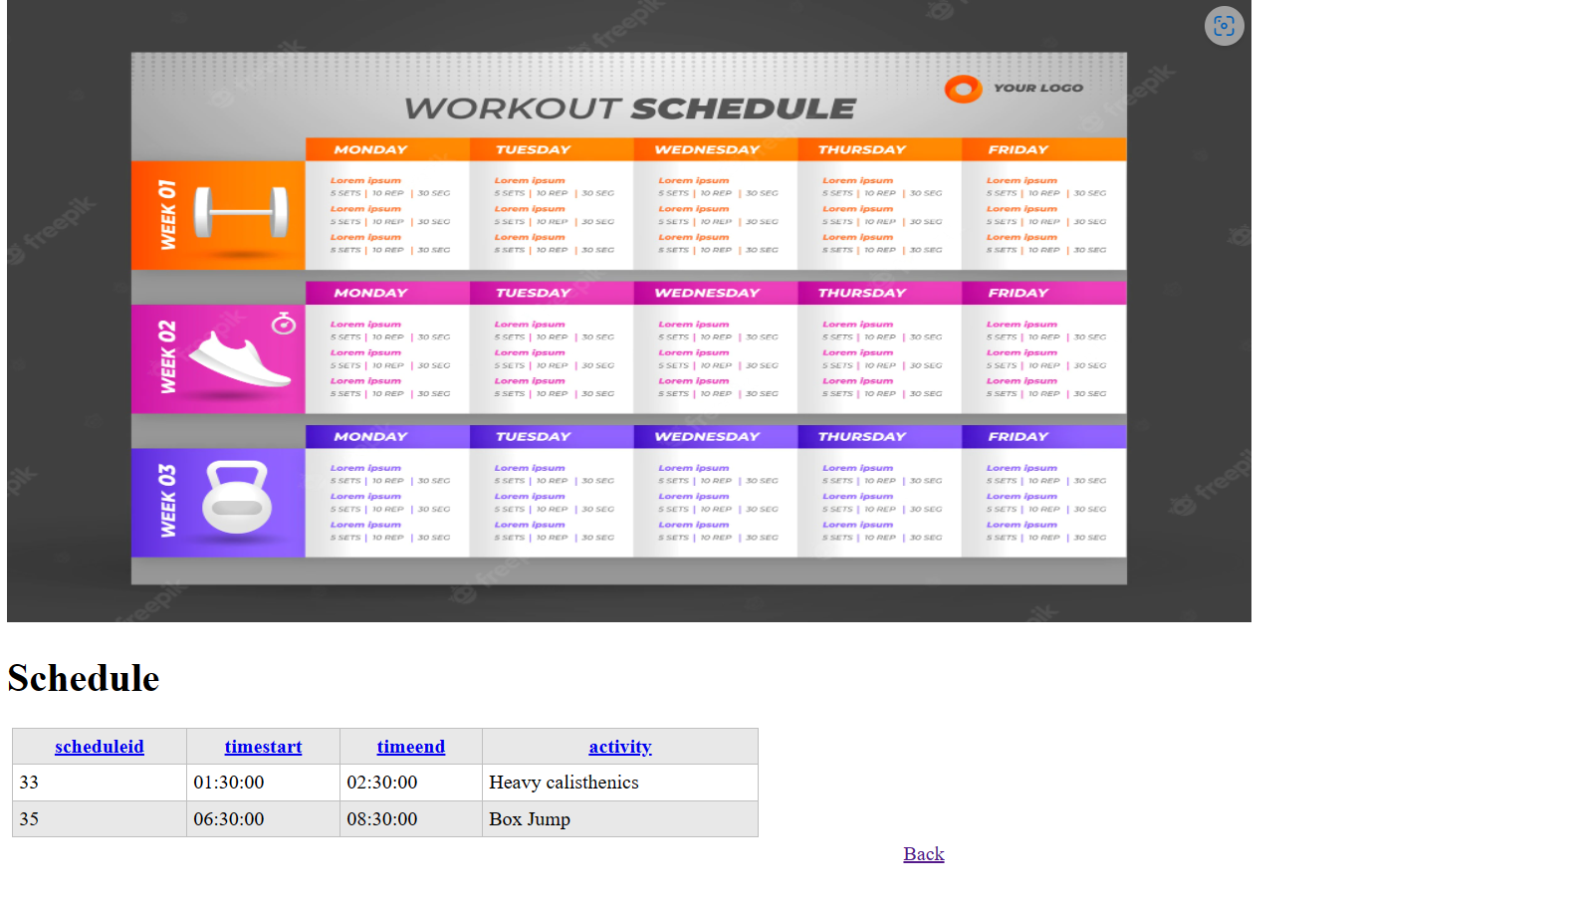
Schedule Interface

Slide 10
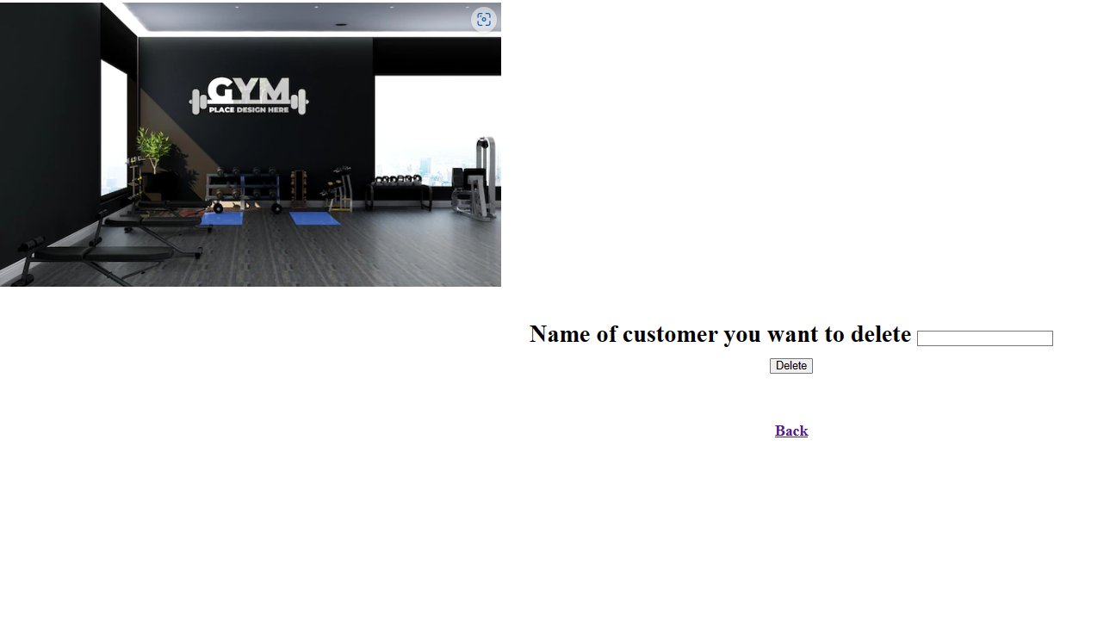
Delete Interface

Slide 11
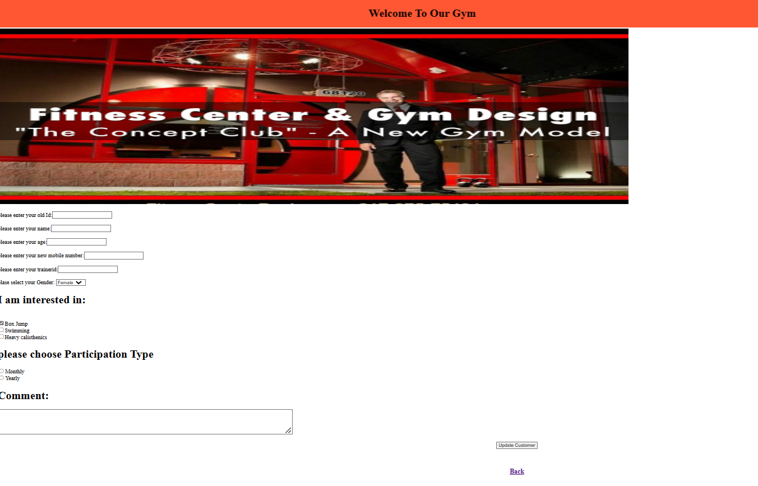
Update Interface

Slide 12


